Slide 1
The Network Services Interface
An Overview of the NSI Framework and the GLIF Automated GOLE dynamic network provisioning demonstration at
Supercomputing 2011

Slide 2
NSI Framework
The “NSI Framework” is an OGF standard:
It specifies an abstract model of a network “Connection”
It specifies an abstract “Topology” model over which Connections are established
It specifies an abstract “Network Service Agent” (NSA) that represents each network service region.
It specifies a high level protocol model between NSAs to enable inter-domain NSI Services.
The NSI Framework is technology agnostic
The NSI architecture does not expect or require specific transport technologies in the underlying infrastructure.
It is therefore suitable for multi-layer, multi-protocol, multi-service data transport environments.
It is secure by design, giving each agent full authority over their local processes and policies with explicit - but service specific - authorization performed at each service boundary for all inter-domain requests.

Slide 3
Why NSI? Why now?
Emerging applications require predictable and deterministic network resources. Connection oriented services can meet these needs.
In a global environment, these services must be automated in order to scale, and must be inter-domain in order to provide the reach required of global science, and they must be secure to be globally practical.
Much work has been done to develop effective protocols for automated provisioning, … but these protocols have been experimental, and/or do not address the larger architectural aspects of a global environment.
And existing approaches are rarely interoperable – resulting in limited and isolated islands of functionality.
NSI leverages much this prior work and experience to define an inter-domain architecture and a provisioning standard that is technology agnostic, secure, and globally scalable.
The NSI Framework and protocol(s) are the product of an open and community-wide process within the Open Grid Forum.
The result is a consensus standard that meets a wide range of needs…and is widely understood and widely supported, and will therefore be widely deployed in networks and widely adopted by applications.

Slide 4
A Basic Overview of NSI Architecture
Network Services Agent
NSA
Requesting
Agent (RA)
Network Services Interfae
B
Provider
Agent (PA)
NSI protocol
NSA
A
C
Network Resource Manager
NRM
A
E
D
D
E
Domain B
Domain C

Slide 5
The Network Service Agent
A Network Service Agent is associated with every NSI Network domain:
It acts as Provider Agent (PA) when receiving service requests for other NSAs (peer networks or user clients)
It can act as a Requesting Agent (RA) to farm out portions of the resource management to other NSAs (networks)
It interacts with an independent Network Resource Manager (NRM) to allocate and reserve network resources within its own network domain

Slide 6
NSI Connection Service
The NSI Connection Service (NSI-CS) is the first protocol defined under the NSI Framework
NSI-CS specifies a set of basic primitives and functional capabilities that create and manage a NSI Connection through its life cycle.
NSI-CS Features:
Supports Reserve, Provision, Release, Terminate, and Query primitives.
Supports conventional “chain” signaling but also incorporates novel “tree” signaling - providing greater flexibility and control to the Requesting Agent – i.e. the user.
Allows users to schedule connections in advance.
Allows service providers to define common service specifications to aid in end to end service interoperability

Slide 7
Basic NSI Topology Model
P₂
L₁
P₁
P₂
P₀
X₁
Bonaire
Conventional physical infrastructure –
Networks, switches, ports, and links
X₀
P₀
P₁
Aruba
The physical topology is translated to a derivative “resource graph” consisting of resources, and stitching relations
P₄
P₁
P₂
The NSI model assigns ownership of all physical components to one network or the other.
P₂
P₀
X₁
X₀
L₁
P₀
P₁
P₅
Aruba
Bonaire
Technology agnostic inter-domain Service Termination Points (“STP”s) are defined and mapped logically to internal physical components. External relations are NSI Service Demarcation Points (“SDP”s).
P₂
B₂
P₂
A₀
P₁
A₂
P₀
P₄
X₁
X₀
L₁
B₁
P₅
P₀
B₀
A₁
P₁
Aruba
Bonaire
By hiding all internal structure and only exposing inter-domain STPs and their peering SDP relations, we arrive at the basic NSI Topology Model of networks, STPs, and the SDPs that indicate inter-domain adjacency.
STP
Aruba:A₂
Aruba
Bonaire
SDP
STP
Bonaire:B₂
Aruba:A₁
Aruba:A₀
Bonaire:B₁
Bonaire:B₀

Slide 8
How NSI-CS Works…
The user application
RA
PA
Appl
NSA
NSA
NSA
NSA
RM
RM
RM

Slide 9
Anatomy of a Connection
Ingress
Service Termination Point
“A”
Egress
Service Termination Point
“Z”
Access section
Access section
Ingress Framing
Transport section
Egress Framing
Transport framing
The User (RA) specifies connection constraints (ostensibly externally measurable) for the access portion of the service instance
The Network (PA) decides how to fulfil those constraints across the transport section.

Slide 10
Network Service Agent Request processing path
Chain model
RA
PA
PA
PA
1
2
3
M
3rd party request
A
B
C
D
6
5
4
1
6
2
3
B
C
D
A
Z
5
4
A
Z
Tree model
A
6
1
3
5
2
4
B
C
D
A
Z

Slide 11
Mixed model request handling Request processing path using mixed model
A
1
Tree model
8
B
C
D
2
7
Chain model
6
5
3
4
Chain model
Tree model
RA

Slide 12
NSI Connection Service Protocol Exchange
This is the life cycle msg sequence between the NSI Connection Service (PA) and the requester (RA) for a normal successful connection request.
RA
PA
idle
reserve
request
idle
reserve
reserve
complete
reserve
scheduled
setup
request
scheduled
Setup
Complete
“Setup” TIme
init
“Start” TIme
In Service
Release
Request
In Service
“Duration” TImer
Released
Release
Complete
Released
idle

Slide 13
The GLIF Automated GOLE Pilot Project

Slide 14
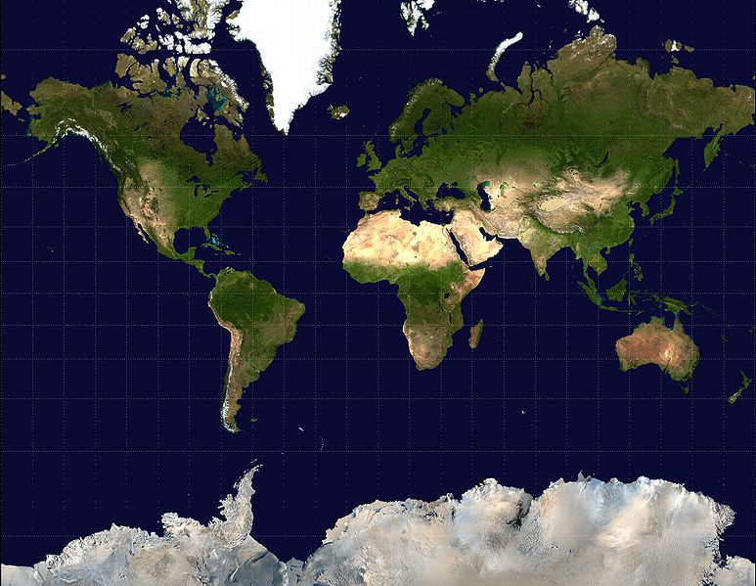
The Automated GOLE Fabric
Nordunet
KRLight
GLORIAD
NetherLight
PSNC
StarLight
GEANT
ACE
CzechLight
KDDI Labs
JGN-X
ESnet
UvA
Cern
MANLAN
USLHCnet
AIST
Cal Tech
The Global Lambda Integrated Facility (GLIF)
The GLIF Automated GOLE Pilot was initiated in 2010 to provide a global fabric of Open Lightpath Exchanges for the express purpose of maturing the dynamic provisioning software, demonstrating the value of GOLEs to emerging network service models, and to develop a set of BCP for these services.

Slide 15
The NSI Demo at SC2011
The Playground

Slide 16
NSI Software Implementations:
OpenNSA – NORDUnet (Copenhagen, DK)
DRAC – SURFnet (Amsterdam, NL)
AutoBAHN – GEANT (Poznan, PL)
G-LAMBDA-A - AIST (Tsukuba, JP)
G-LAMBDA-K – KDDI Labs (Fujimino, JP)
DynamicKL – KISTI (Daejeon, KR)
OSCARS – ESnet (Berkeley, US)

Slide 17
Watch it Live!
Visualization
Java web start thing: http://163.220.30.174:8070/monitor.jnlp
Google earth plugin: http://kote-ps-1.ps.jgn-x.jp/ps/autoearth-nsi/
Google earth kml: http://kote-ps-1.ps.jgn-x.jp/ps/autoearth-nsiAutoMAP.kml

Slide 18
NSI Development & Road Map
OGF NSI-CS version 1.0 is in final draft now
Demos:
Sep 2011: First NSI CS Interop Plugfest – GLIF 2011 Rio de Janeiro, BR
Oct 2011: First NSI Transport Provisioning Future Internet Assembly 2011 Poznan, PL
Nov 2011: Global NSI + AutoGOLE Demonstration Supercomputing 2011 Seattle, US
Futures:
NSI Topology – dynamic distributed topology exchange. Required to automated the local maintenance of local topology and to enable scalable global pathfinding.
NSI Performance Verification – An architecture for automated service verification and fault localization/remediation
Common Service Definitions – Enabling interoperable transport services

Slide 19
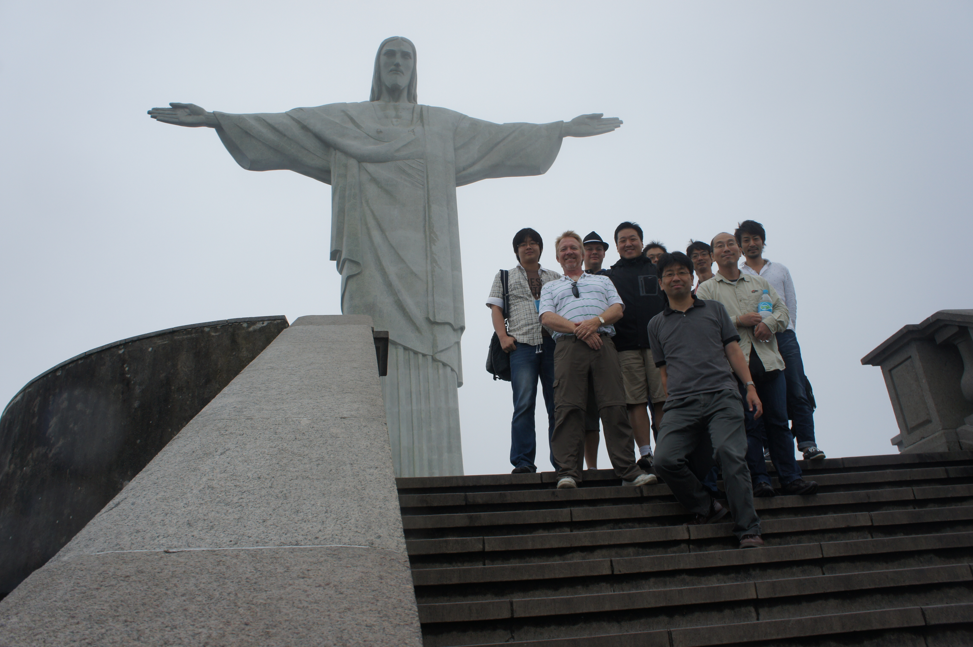
Key Endorsements
I once made a connection thiiiiiis long using NSI CS v1.0
NSI is gaining very broad support.

Slide 20
OGF NSI Working Group
The OGF NSI WG is an Open working group
This means if *you* have ideas you would like to see incorporated into the NSI framework and/or protocols, please get active in the process:
Contact one of the active WG members and pick their brain
Join the mailing list, lurk and get up to speed, then join the calls…
Contribute – ask, comment, propose…help us sort thru the issues to achieve clarity within the group and consensus within the broader community
Thank You!

